Slide 1
Heart Disease Factors:
The Potential of Computerized Predictor Selection
Jayarethanam Pillai, Lakshmi, Zaki

Slide 2
Objectives
Problem Statement: Can we improve the accuracy of diagnosing heart disease in patients by considering not only the risk factors well-known among medical professionals, but also risk factors identified by computer-generated prediction models?
Objective: To demonstrate that computer-based risk factor identification is a valuable tool to complement established medical knowledge in the diagnosis of heart disease.

Slide 3
The Data
13 attributes were assessed against the ‘Target’ - determining if a patient is in danger of developing a heart disease.
Patients Ages (29 to 77),
Sex (206 Males and 97 Females),
Chest Pain/ CP type (1- high chance of blockages , 2- less chance of blockages, 3- prolonged severe pain, 4- no noticeable symptoms)
Trestbps (resting blood sugar level)
Cholesterol level
FBS (Fasting Blood Sugar)(Above 120 mg/dl = 1, otherwise 0)
Restecg ( Electrocardiographic results) (0 = normal, 1 = abnormal, 2 = probability of thickening of wall of heart’s main chamber)
Thalach (Maximum heart rate of each patient)
Exang (If there is chest pain caused by exercise)
Oldpeak (degree of dip in the electrocardiogram caused by exercise)
Slope (Electrocardiography slope at exercise peak)
CA (Number of major vessels)
Thal (Cardiac stress test)
Which of the above attributes are predictors of a heart disease, the target? 0 is healthy, 1 - small chance of a heart disease, 2 - a slightly higher chance of developing a heart disease, 3 - likely to develop a heart disease, 4 - very high possibility of developing a heart disease.

Slide 4
Methodology
Using a deduction technique to analyse the data with the given heart disease dataset from the Cleveland Database
The ‘Target’ variable is used as a Dependent Variable - Data with the presence of healthy or heart disease for sick type: 1, 2, 3, and 4.
Using EDA to dissect the dataset, offering insights and composition of the 303 patients (32% female & 68% male)
Developing a heart disease prediction model, by undertaking a train-test-split model using the given 13 independent variables in slide 3
We compare the results to offer assessment if such models improve to predict heart disease in patients

Slide 5
Results
Model | Medical Knowledge based Model | Medical Knowledge + Statistical based Model
Predictors | cholesterol, blood pressure, heart rate, resting ECG, blood sugar, exercise induced angina, age | cholesterol, blood pressure, heart rate, resting ECG, blood sugar, exercise induced angina, age, number of major vessels colored by fluoroscopy, heart status, ST depression
Predictive Score | 0.21 | 0.56
Benchmark | 0.6 - 0.8

Slide 6
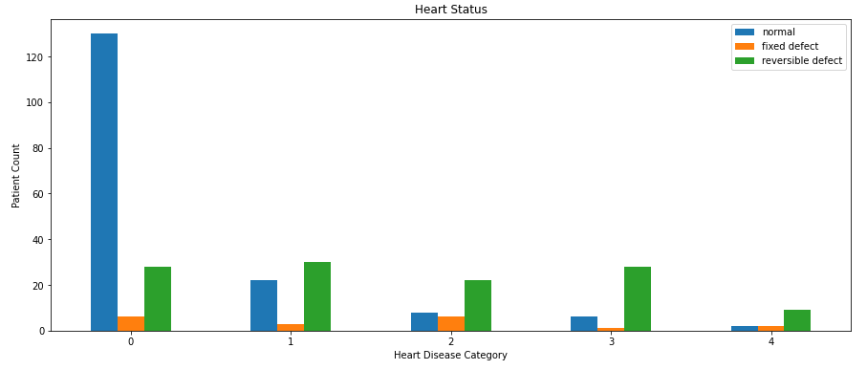
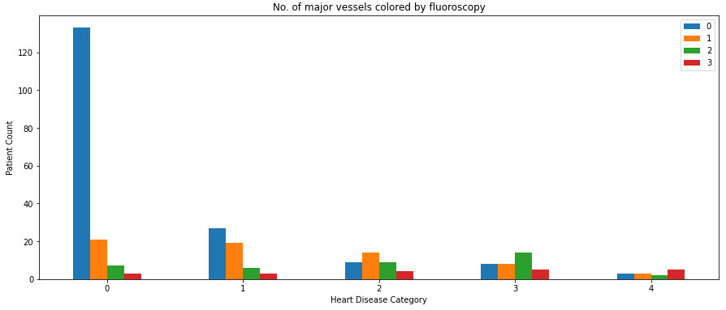
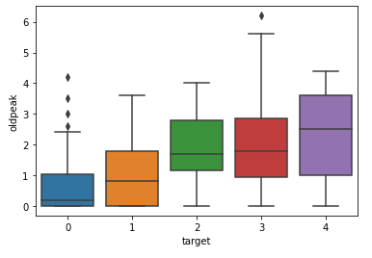
Results

Slide 7
Recommendations
Although there are several limitations to overcome to be able to implement ML algorithms in clinical practice, overall ML algorithms showed promising results.
SVM and boosting algorithms are widely used in cardiovascular medicine with good results.
However, selecting the proper algorithms for the appropriate research questions, comparison to human experts, validation cohorts, and reporting of all possible evaluation matrices are needed for study interpretation in the correct clinical context.
Most importantly, prospective studies comparing ML algorithms to conventional risk models are needed.
Once validated in that way, ML algorithms could be integrated with electronic health record systems and applied in clinical practice, particularly in high resources areas.

Slide 8
Limitations
The data partition is also arbitrary because of no standard guidelines for utilization.
Feature selection methodologies, and techniques are arbitrary and heterogeneous.
Due to the ambiguity of custom-built algorithms, we could not classify the type of those algorithms.
Some analyses did not correlate with the clinical context, which made it more difficult to interpret.
Clinical data are heterogeneous and imbalanced. (male and female patients); widening the age group assessments due to include lifestyle impact on getting heart disease.
Several other parameters that are usually used in clinical assessments are not found here[BMI, smoking, genetics, etc]

Slide 9
Thank you!

Slide 10
Appendix
Anna Karen Garate-Escamila, Amir Hajjam El Hassania, Emmanuel Andres (2020). Classification models for heart disease prediction using feature selection and PCA, Informatics in Medicine Unlocked (19).
Fatma Zahra Abdeldjouad, Menaouer Brahami & Nada Matta (2020. A Hybrid Approach for Heart Disease Diagnosis and Prediction Using Machine Learning Techniques, in M. Jmaiel et al. (Eds.), ICOST, LNCS 12157, pp. 299–306.
Jesmin Nahar, Tasadduq Imam, Kevin S. Tickle, Yi-Ping Phoebe Chen (2013). Computational intelligence for heart disease diagnosis: A medical knowledge driven approach, Expert Systems with Applications 40, pp. 96 - 104.

Slide 11
Results
The prediction model built using medical knowledge based predictors attained a score of 0.21 for predicting outcomes.
This falls short of the benchmark of 0.6 for a model which would reasonably be able to classify the heart disease status of new patients.

Slide 12
Results
In contrast, the model using medical knowledge and the 3 predictors with the highest statistical relationship attained a score of 0.56 for predicting outcomes.
While the score is still lower than the minimum score of 0.6 for a good model, the model showed an improvement in prediction capability over the previous approach using only medical knowledge based predictors

